Slide 1
Basic paradoxes of physics and Universal arrow of time
Dr. Kupervasser Oleg

Slide 2
Second law of thermodynamics

Slide 3
Contradiction between the second law and reversible laws of physics
The entropy of a closed system in a finite volume can only increase until achievement of its maximum – thermodynamic equilibrium
It is in contradiction with reversibility:
a) Poincare paradox
b) Loshmidt paradox

Slide 4
Contradiction between reduction of wave packet and Schrodinger equation (Unitary evolution) in quantum mechanics
Von-Neumann entropy does not change during Schrodinger evolution, but increases during reduction
Schrodinger cat paradox is an illustration of the reduction paradox

Slide 5
Information paradox of a black hole

Slide 6
Information paradox of a black hole
There appears irreversible disappear of information in a black hole. It is contradict to reversibility of motion. Indeed, during reverse, the information restores.
Is it possible to reverse black hole? Directly it is not possible. But it is possible to connect the black hole with a white hole in some different Universe by a wormhole.
(Nikodem J. Poplawski “Radial motion in an Einstein-Rosen bridge”).

Slide 7
Wormhole

Slide 8
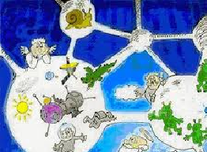
Wormhole -properties
Wormhole resolves Arthur Clarke’s paradox about senseless to far stars by the space transportation of one of “mouths” of a wormhole.
Wormhole help to save our civilization from Our expanding Universe by transportation to a different Universe through a wormhole
Macro-wormhole can be created from micro-wormholes existing in quantum vacuum fluctuation
Time-like wormhole appears as a result of traveling of one of “mouths” of a wormhole with almost light velocity over closed trajectory. Such Time-like wormhole can be used as a time machine for traveling to the past.

Slide 9
Wormhole – grandfather paradox
Grandson can returns to the past and kill his grandfather

Slide 10
Occam’s razor
We use Occam’s razor during paradoxes’ resolution
Don’t create new laws without necessity!

Slide 11
Why we need arrow of time for paradoxes resolution?
Physics is experimental science
Physics is verified by comparing observable system evolution with theory prediction
Observer is irreversible macroscopic system with own time arrow and memory
Macroscopic system consists of large number of molecules, chaotic and has small interaction with observer/environment

Slide 12
Why the observer’s time arrow is important for the observable system?
Small interaction exists between real observer and observable system
This interaction is not neglectable

Slide 13
Why does it resolve the paradoxes?
Their problematic consequences become unobservable experimentally for a real observer.

Slide 14
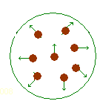
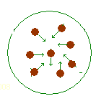
Example of two vessel with gas – instability of shrinking
Gas expanding
Gas shrinking

Slide 15
Macroscopic entropy increasing paradox resolution
Direction of time arrow is defined by the entropy increase
Time arrows alignment appears as a result of observer/environment small interaction with observable system
From here we can get two resolutions of Poincare and Loshmidt paradoxes^
1) Time reversing appear synchronously for observer and observed system (full system)
2) For full system, it is impossible observation of reverses because of observer memory erasing
Condition with opposite time arrows is unstable. Small interaction results in time arrows alignment. As a result all time arrows in the Universe have the same direction. Positive direction of time arrow defines the entropy increase direction. Therefore the entropy increases in all parts of the Universe.

Slide 16
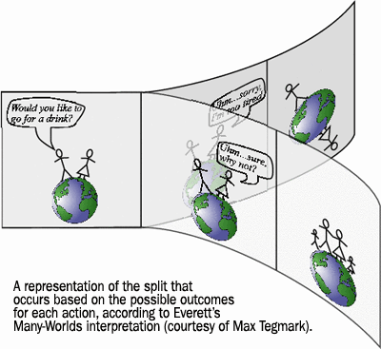
Multi worlds interpretation: non-probabilistic unpredictability as a result of quantum correlations

Slide 17
Experiment with Schrodinger cat from point of view of external observer and from point of view of the cat (self-observation) Reduction of the final observer during observation.

Slide 18
Resolution of the Schrodinger cat paradox
System return to initial state because of quantum correlations. This return can not be registered during self-observation because of memory erasing
During reversing, time arrows of observer and observed system reverse synchronously.
Small errors because of quantum correlations are unobservable because of incompleteness of self-observation.

Slide 19
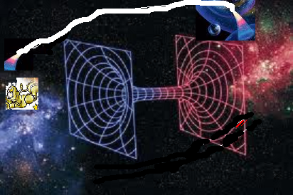
Information paradox resolution for black holes
Complete instability of a black hole
Small gravitation of the observer results in experimental non-observation of information paradox. Indeed, the observer destroys information’s correlations

Slide 20
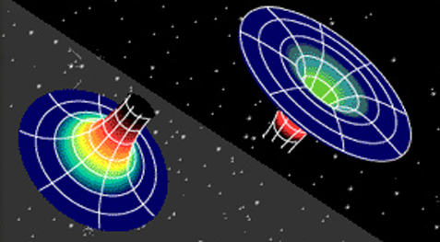
Resolution of the grandfather paradox
1) Time-like macro-wormholes: time arrows alignment of the observer and the radiation in wormhole destroys the observer
2) Time-like micro-wormholes :topology destroying

Slide 21
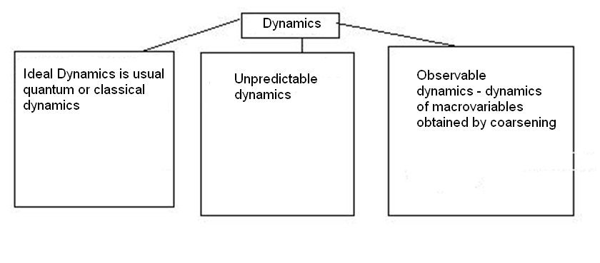
Tree types of dynamics

Slide 22
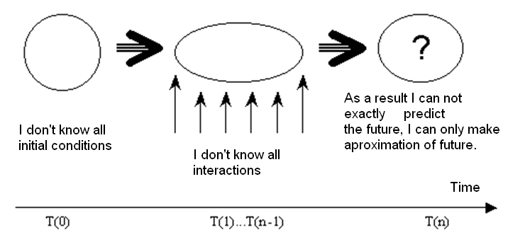
Unpredictable dynamics

Slide 23
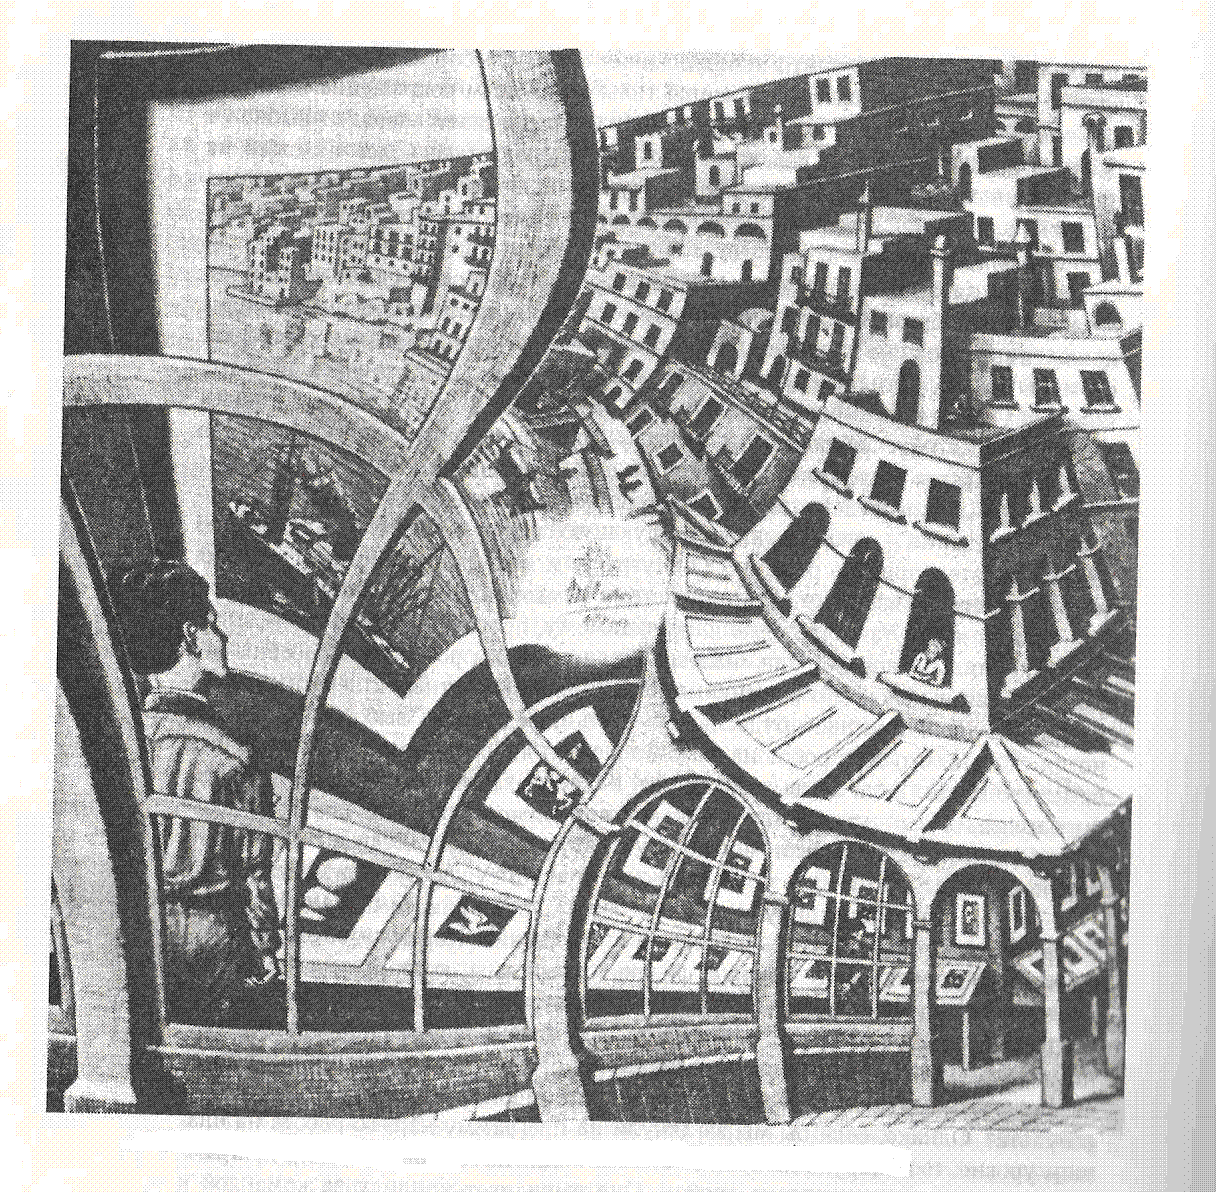
Escher “Picture gallery” is an illustration of the problems of self-observation

Slide 24
Impossibility of self-prediction

Slide 25
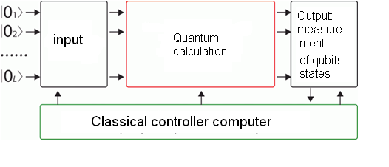
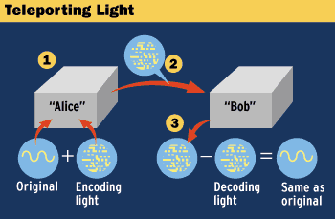
Practical application of the unpredictable systems (quantum computers): 1) features for recognition are macro-parameters 2) random generator with correlations with environment

Slide 26
Oleg Kupervasser
olegkup@yahoo.com

